Slide 1
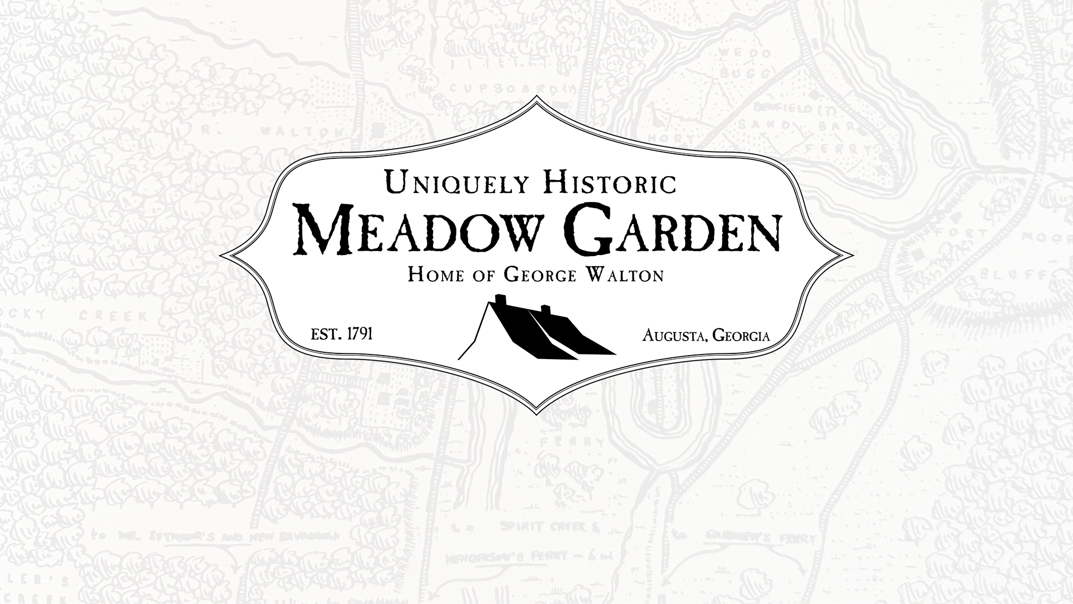

Slide 2
Preserving History. Inspiring Possibilities.
A rare piece of Georgian and American history
Enduring reminder of the sacrifices our founding fathers made
Plans to preserve and restore it to a more authentic representation of the period
Landmarks teach children about the formation of our country and our founders
We look to the generosity of those who wish to interpret the history of George Walton through the preservation of this house of national significance, inspiring generations to come.

Slide 3
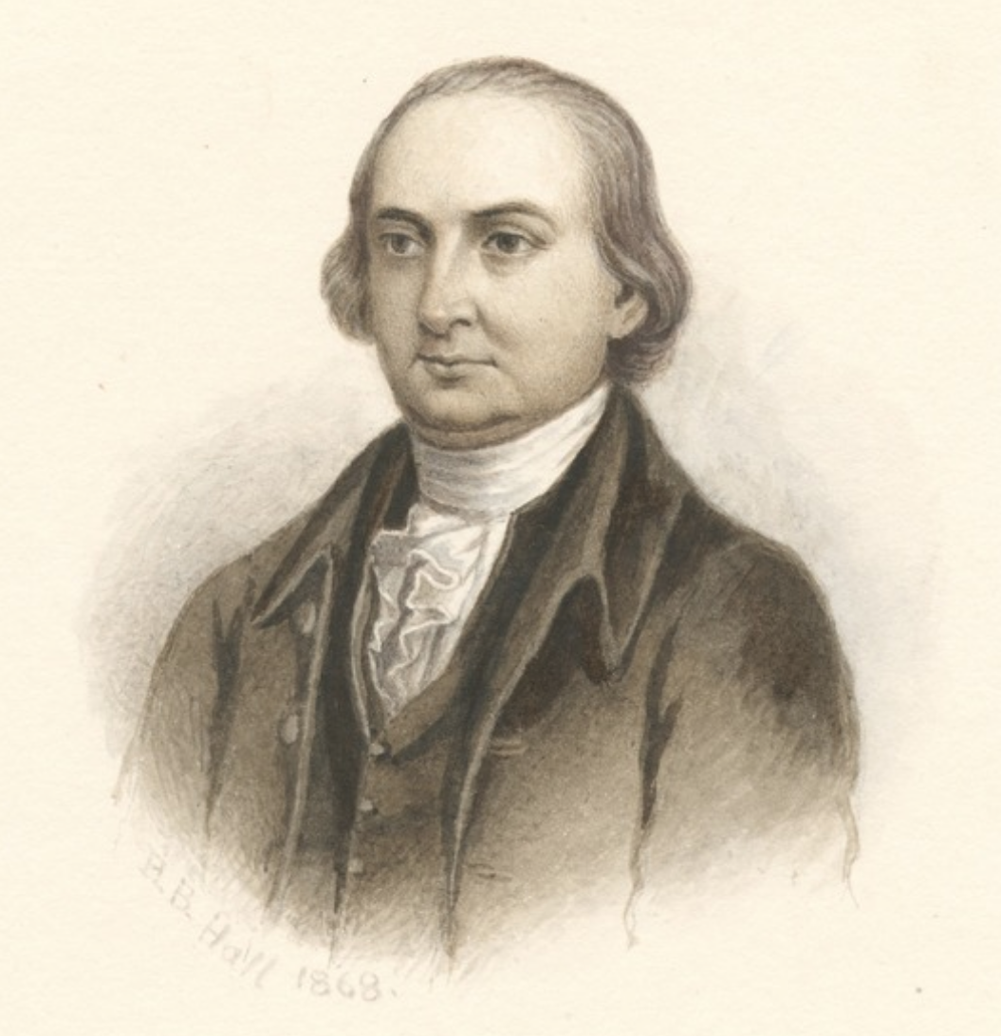
George Walton From Orphan to Founder
He was orphaned at a young age
Apprenticed as a carpenter, he pursued an education
Walton rose to become a lawyer, patriot
One of the most prominent citizens of the State of Georgia
George Walton became involved in the early revolutionary efforts in Georgia
Served as the secretary for the Provincial Congress
President for the Council of Safety
Elected to the Second Continental Congress
Signed the Declaration of Independence—at 26 years of age

Slide 4
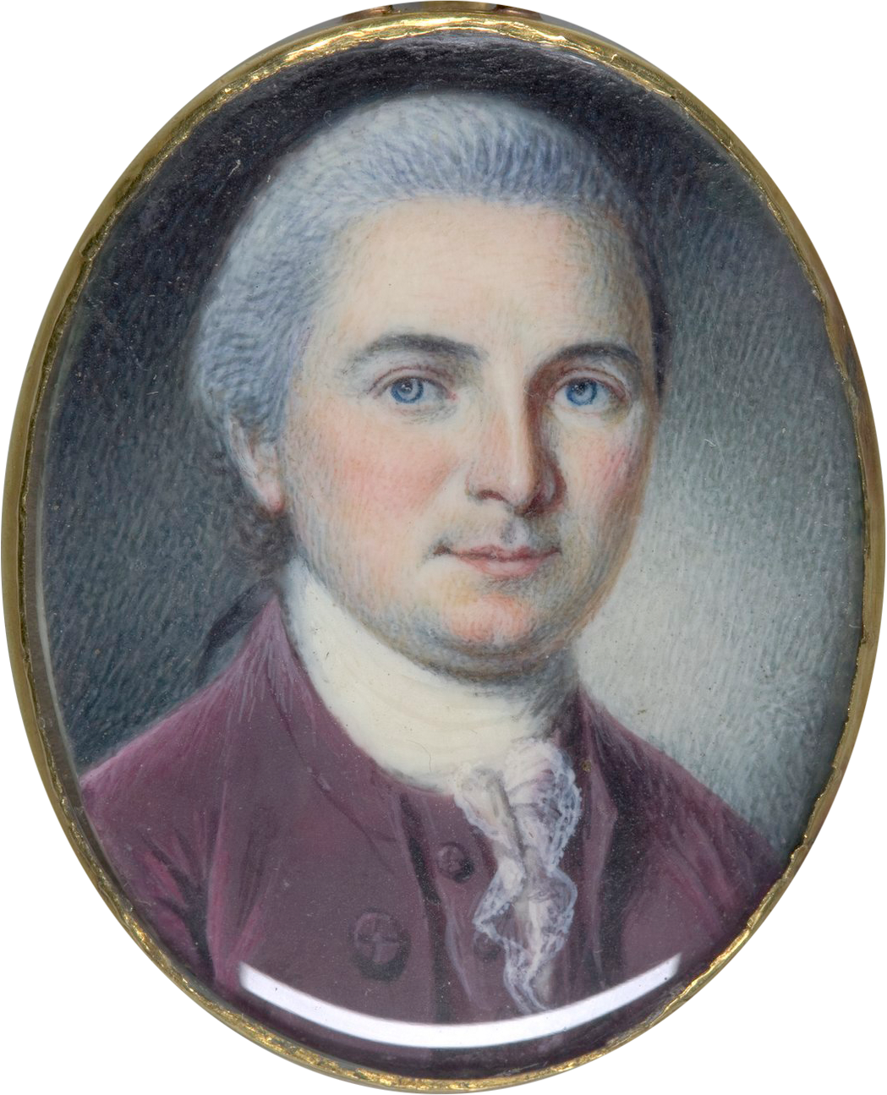
Served as a Colonel in the Georgia Militia
Wounded and taken prisoner by the British
Held at Sunbury as a prisoner of war for 10 months
Twice governor of Georgia
Again in the Continental Congress
A United States senator
Three times the chief justice of Georgia
Died in 1804
His life is that of possibilities. He pushed past every boundary and, as a determined young patriot who rose to power, gives us a unique lens to view our founders.

Slide 5
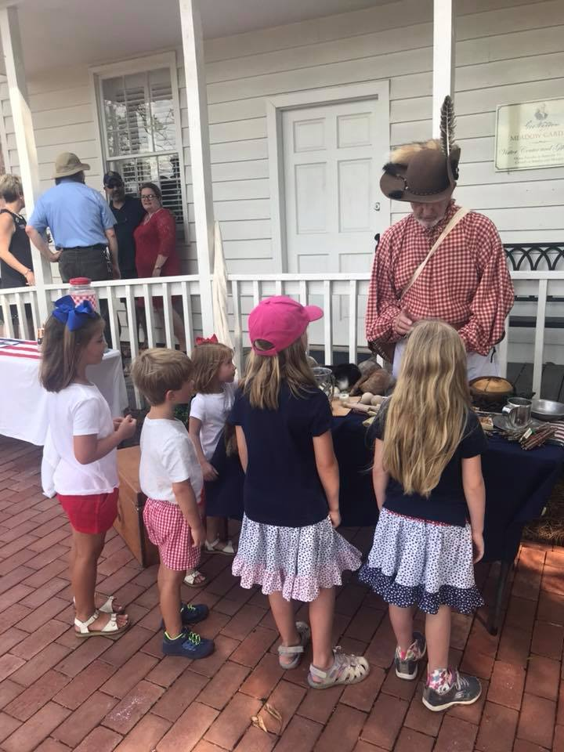
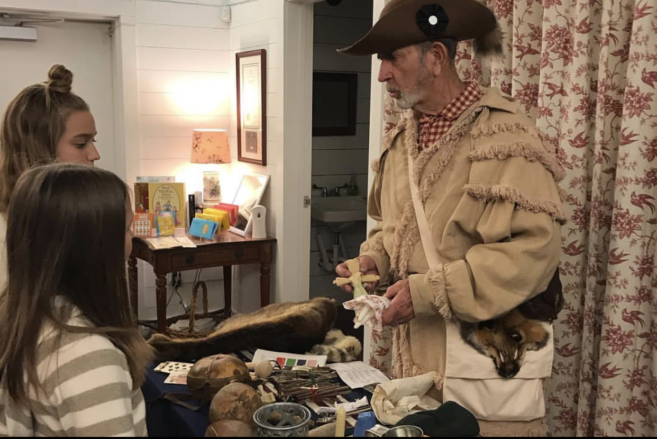
Each year, we welcome visitors and school children to connect this important piece of history to the next generation of Americans, inspiring new possibilities in the hearts of young patriots.

Slide 6
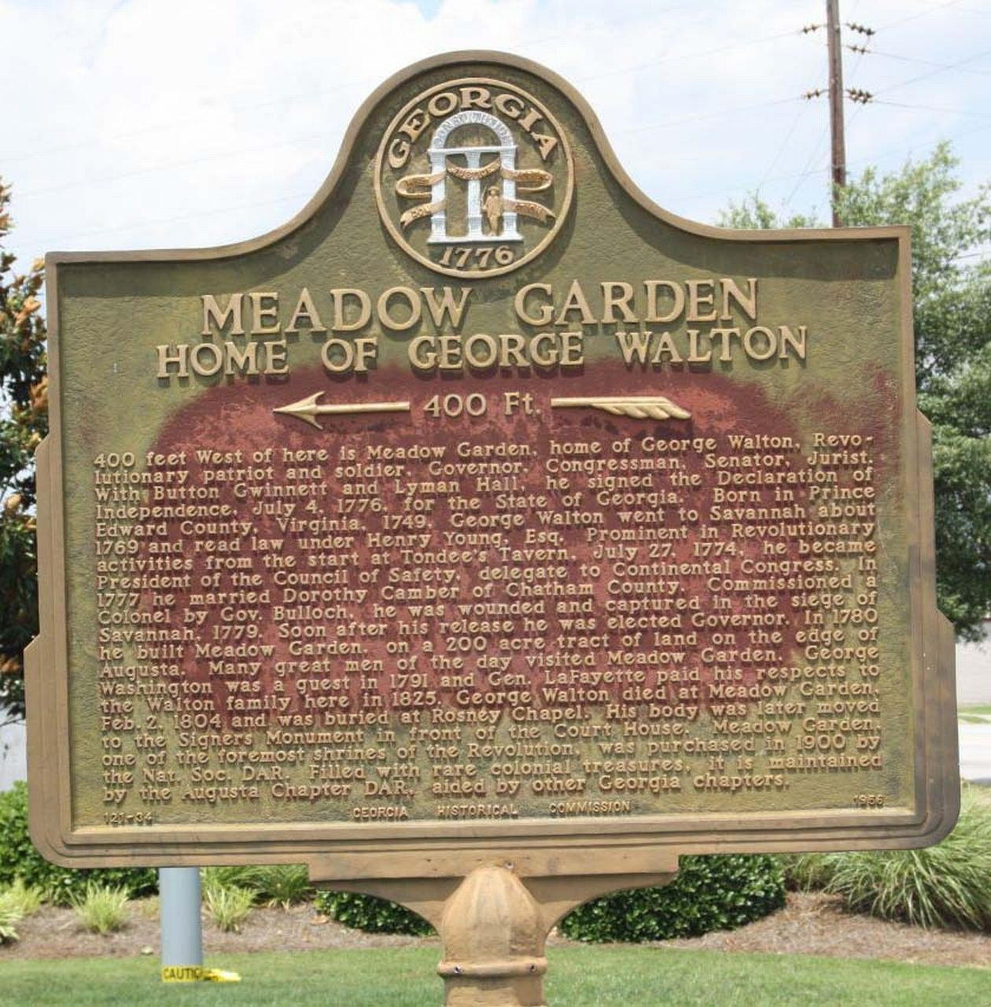
Restoring History: Honor the Past. Teach the Next Generation.
The importance of this preservation effort cannot be overstated
Meadow Garden considered to be the oldest documented house in Augusta
Is also reputedly the first house museum in the State of Georgia
Many changes made to the house and grounds over time, have eroded the historic fabric of the house as it relates
to its most prominent occupant; Senator, Governor, Delegate to the Continental Congress, and signer of the Declaration of Independence, George Walton, and his family.

Slide 7
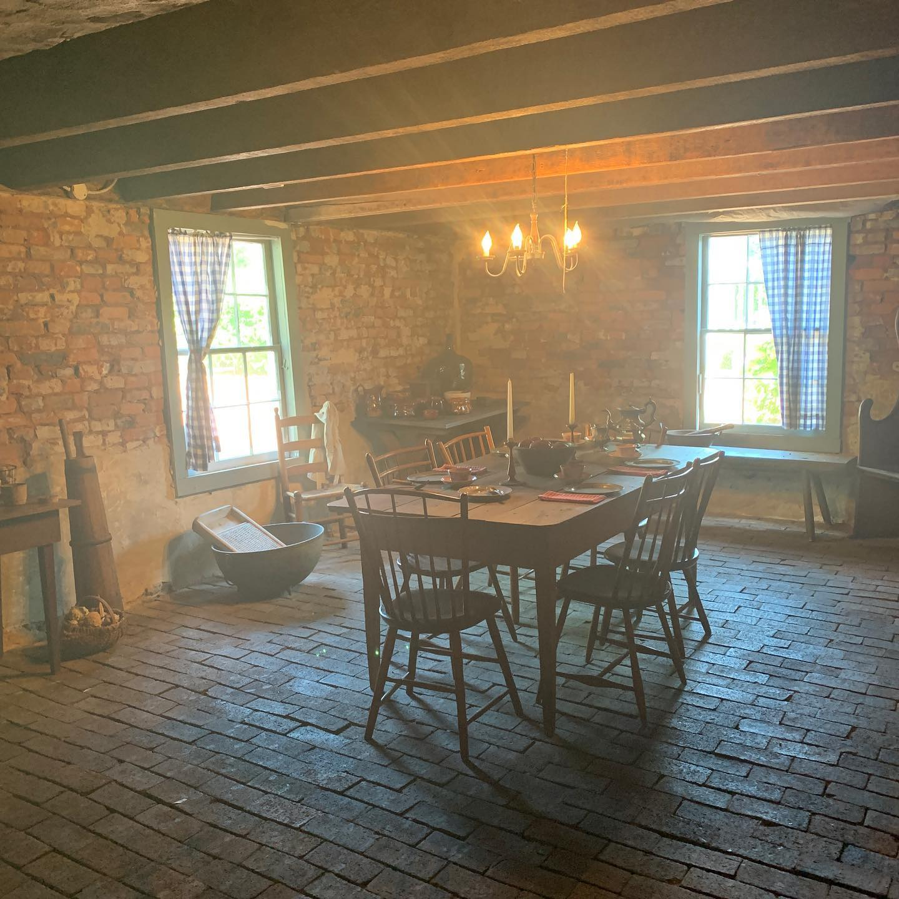
Built in 1791
Meadow Garden was the Waltons’ primary home
At George Walton’s death, his funeral procession began at Meadow Garden
Has been a part of four centuries
Connects modern visitors to a man who played a vital role in the founding of our country

Slide 8
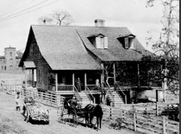
“For the past 120 years, the ongoing stewardship demonstrated by the Georgia State Society Daughters of the American Revolution proves just what can happen with a little vision and many dedicated volunteers, and is a shining example of the impact American women have on our
historic sites.”
The Georgia Trust for Historic Preservation “Excellence in Stewardship” award

Slide 9
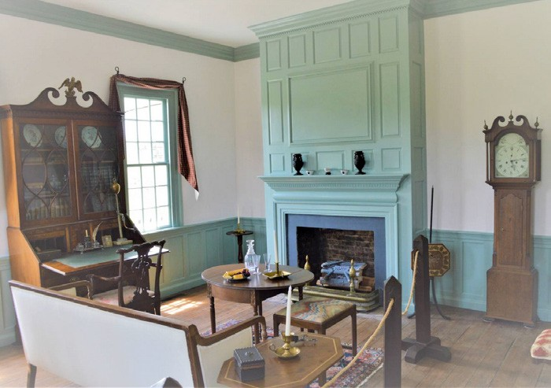
For 120 years, the Georgia State Society Daughters of the American Revolution (GSSDAR) has maintained stewardship
We are using the best information, technology, and resources at our disposal
Restore this historic structure in accordance with the standards of the day
Work to be done to ensure a more authentic representation of the house during the time the Waltons were in residence
In 2018, we commenced our historic restoration and preservation plan

Slide 10
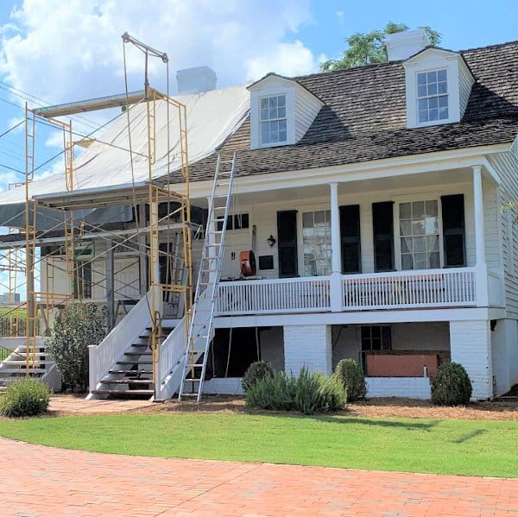
Work completed on the restoration of the front porch
Replacement of the front-porch roofline
With this project, the front-facing portion of the first period roof has been revealed for the first time in more than a century
This provides a more authentic representation of the house during the time the Walton’s were in residence

Slide 11
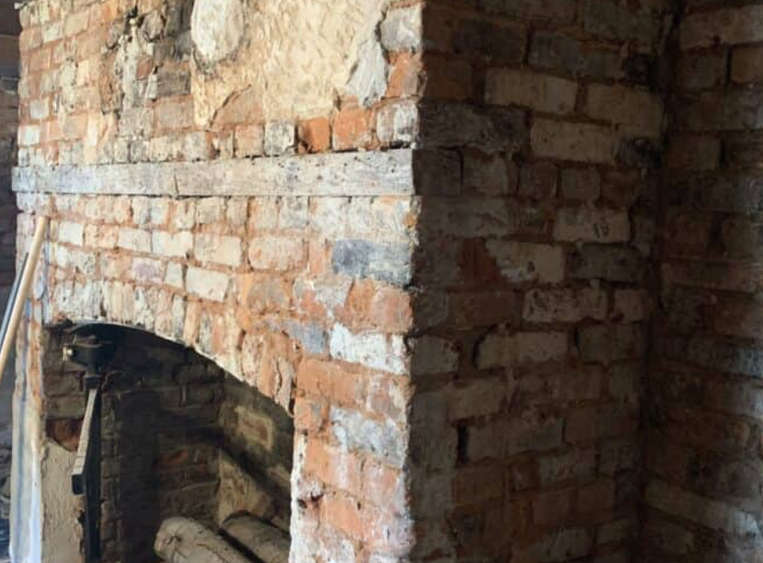
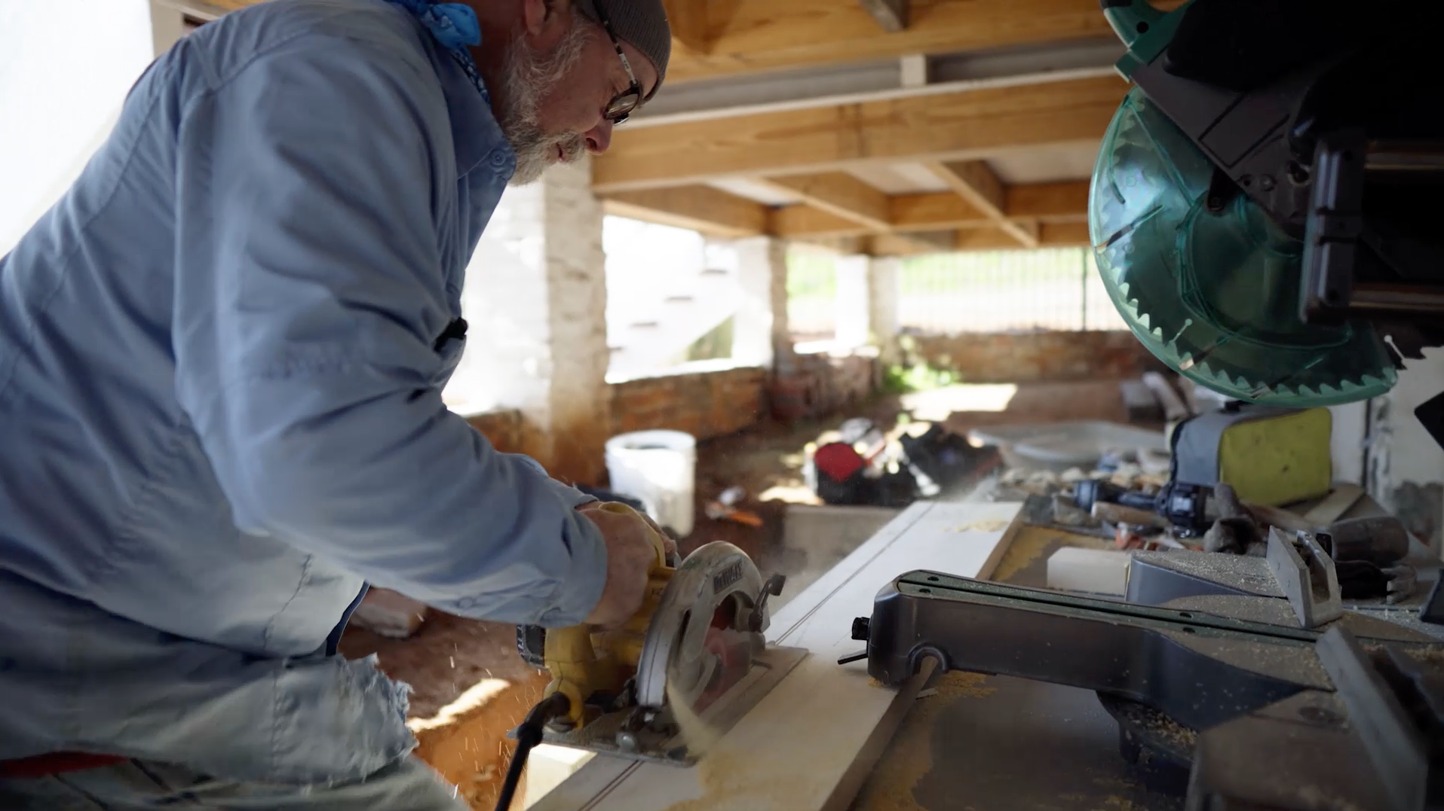
As we are able, we will continue to carry out our restoration and preservation plan to return the home to reflect the Walton’s time there.

Slide 12
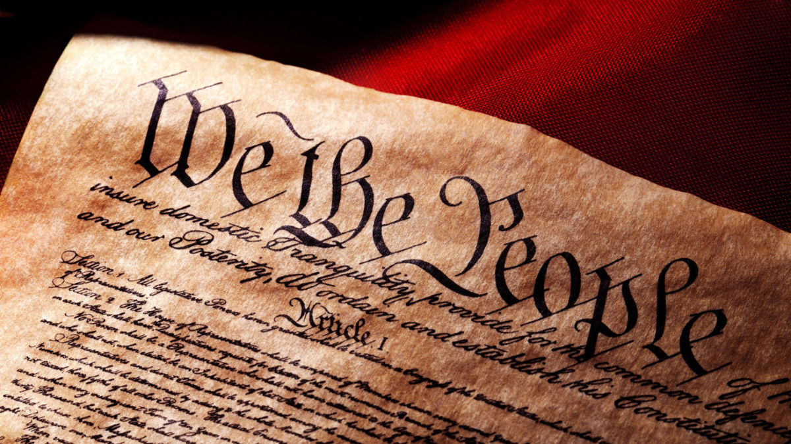
A Plan for the Future
Our preservation plan seeks to raise a minimum of $1,000,000 to support our focus on:
Historic Preservation and Restoration
We plan to preserve Meadow Garden with respect to its earliest period during the Walton family’s time
We will explore the evolution of this historically significant structure while preserving the unique history
George Walton’s signing of the Declaration of Independence is of national importance, and
His role in the founding of our nation has been the main tenet of DAR’s interest in protecting the house.

Slide 13
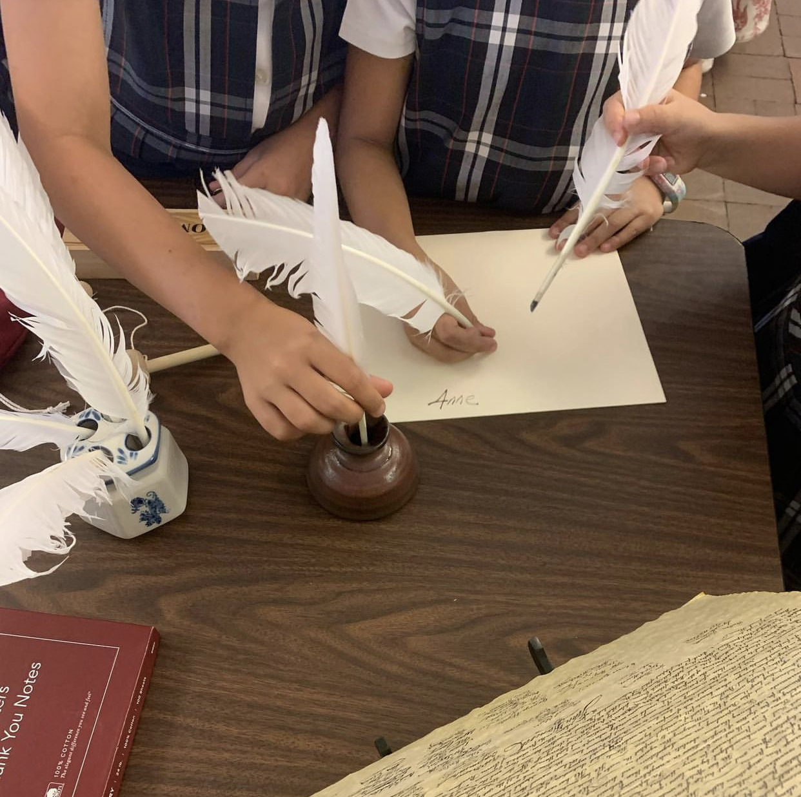
Education
This important historic resource is one of the few places in the country tied to a person who was part of the revolution
Each year, school children visit and connect to this piece of history
Our passion for educating America’s youth calls us to ensure it is available for the next generations
Your support will help us preserve history while inspiring possibilities in future generations. Please support our long-term plan to return Meadow Garden to its historic roots and sustain this rare piece of American History.

Slide 14
Support for Today
This uniquely historic resource is one of the few places tied to a person who was part of the revolution
School children visit and connect to this piece of history
Our passion for educating America’s youth calls us to ensure it is available for the next generations

Slide 15
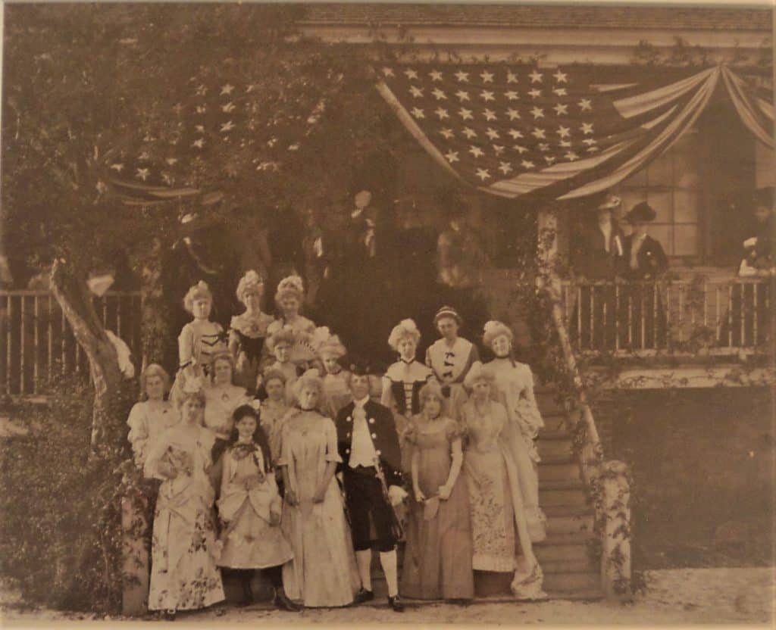
In Our Care: Women Made it Happen
In 1900, the National Society of the Daughters of the American Revolution (DAR) purchased Meadow Garden and placed it in the care of the Georgia State Society
On opening day, November 21, 1901, NSDAR Vice-President General, Mrs. S. C. B. Morgan, proclaimed, “what had been accomplished in restoring Meadow Garden proved of what the American woman is capable.”
The opening and restoration began a proud tradition of preserving this uniquely historic building

Slide 16
The DAR mission is:
Historic Preservation
Education
Patriotism
These timeless, overarching principles keep the DAR strong and vitally relevant in this ever-changing world.
Thank you for your support of Meadow Garden and your commitment to the preservation of our nation’s history.

